Slide 1
IoT features

Slide 2
Overview
Review the history of IoT and its evolution
Examine the IoT ecosystems
Examine IoT core features
Develope IoT architecture and frameworks

Slide 3
IoT history
The expression Internet of Things was originally framed by Kevin Ashton in 1999
OpenSource Hardware (OSH) had maked a significant step change for the invention of Internet-connected products.
Arduino Uno was released in 2005.
Another boost for the IoT came from the Raspberry Pi in 2012
Since the 2010s, there have been countless products for IoT market.

Slide 4
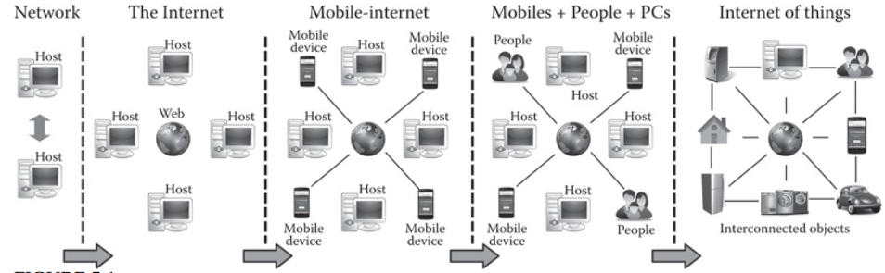
Evolution of IoT

Slide 5
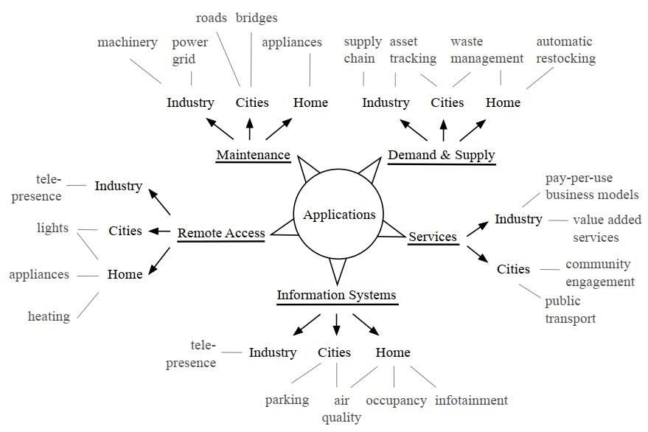
IoT ecosystems

Slide 6
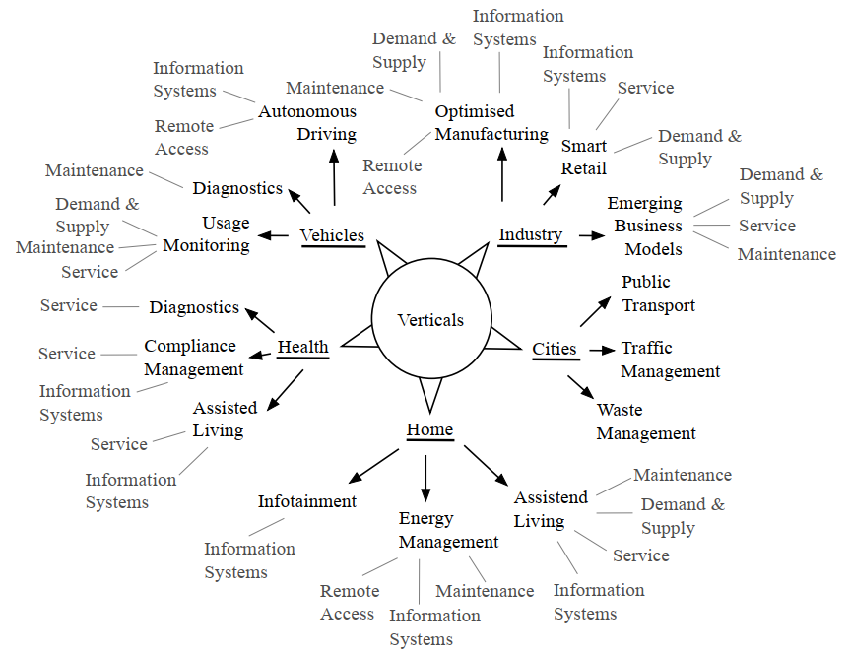
IoT ecosystems

Slide 7
Core functions
Demand and supply management
Maintenance
Information systems
Remote access
Services

Slide 8
Advantages
Efficient resource utilization: connect facilities and digitalize processes is an increase in efficiency
IoT is either a measure to save cost and/or boost profit
Then they minimize the human effort
Enhance Data Collection

Slide 9
Disadvantages
Lack of interoperability
Lack of trust in IoT security
Privacy and data provenance issues

Slide 10

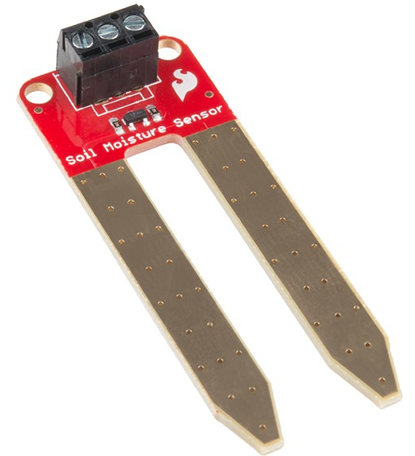
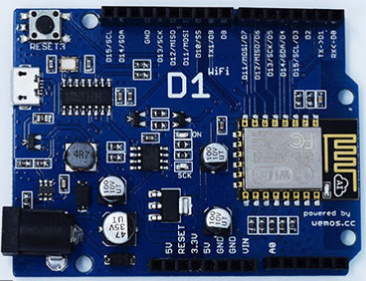
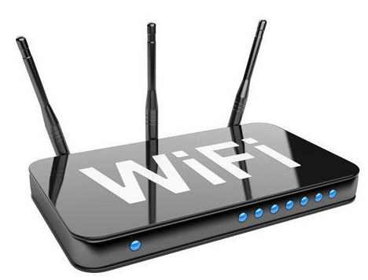

IoT architecture
Sensor/ Actuator
Device
Network/ Gateway
Cloud
Smart app/Data analysis
Notes:
Sensors/Actuators: Sensors or Actuators are the devices that are able to emit, accept and process data over the network. These sensors or actuators may be connected either through wired or wireless. This contains GPS, Electrochemical, Gyroscope, RFID, etc. Most of the sensors need connectivity through sensors gateways. The connection of sensors or actuators can be through a Local Area Network (LAN) or Personal Area Network.
Gateways and Data Acquisition: As the large numbers of data are produced by this sensors and actuators need the high-speed Gateways and Networks to transfer the data. This network can be of type Local Area Network (LAN such as WiFi, Ethernet, etc.), Wide Area Network (WAN such as GSM, 5G, etc.).
Data center/ Cloud: The Data Center or Cloud comes under the Management Services which process the information through analytics, management of device and security controls. Beside this security controls and device management the cloud transfer the data to the end users application such as Retail, Healthcare, Emergency, Environment, and Energy, etc.

Slide 11
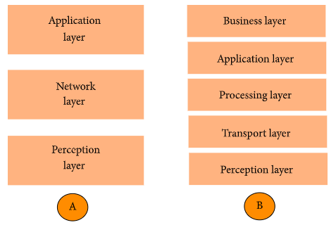
IoT design framework layers

Slide 12
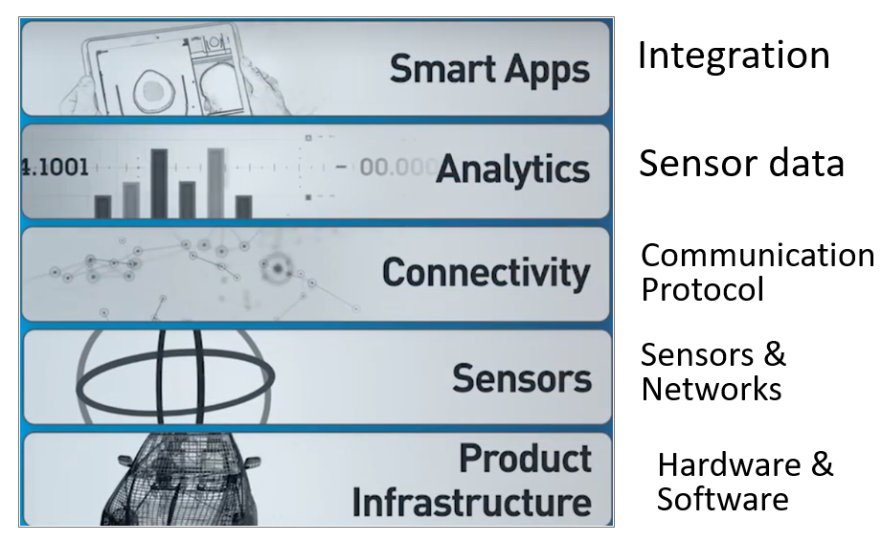
IoT PTC Design Framework

Slide 13
IoT PTC Design Framework
Product Infrastructure layer: Hardware & Software of the product
Sensor layer: sensors & the networks that support them
Connectivity Layer: Communication protocol necessary to send information from the product to the cloud
Analytics layer: translating the sensor data into the meaningful information
Smart Apps layer: integrates all of other layers together and support different business decisions.

Slide 14

Open-loop control system

Slide 15
Close-loop control system
Sensor
(Feedback)

Slide 16
Power supply for IoT devices
With the very large scale charateristic, IoT requires many kind of power supply
Power adapter, AC/DC adapter
USB
PoE (Power over Ethenet)
Battery
Solar panel, solar energy
Wind energy
Fuel cell (may be in the future) ...

Slide 17
Hardware - Sensor
A sensor is a device that detects and responds to some type of input from the physical environment.
The Input: could be light, heat, motion, moisture, pressure, or any one of a great number of other environmental phenomena.
The output: is generally digital data that computer or microcontroller can process.

Slide 18
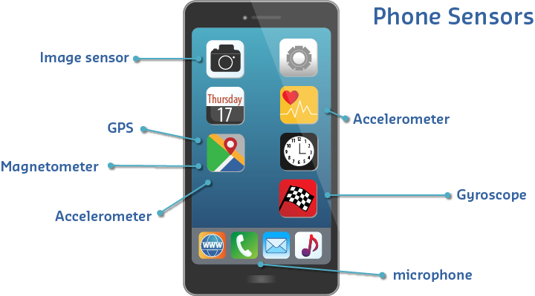
Some sensors in a smartphone

Slide 19
Sensors
Time: IC555
Location: GPS
Motion and acceleration
Force and pressure: button, keypad, joystick
Light: photo resistor
Sound: microphone
Temperature: DHT11, DHT22
Humidity or moisture: soil moisture sensor
…

Slide 20
Hardware - Actuator
An actuator is a device that moves or controls some mechanism. An actuator turns a control signal into mechanical act
The input: is generally digital data that computer or microcontroller send to.
The output: could be light, heat, motion, moisture, pressure, or any one of a great number of other environmental phenomena.

Slide 21
Actuators
Motion: servo motor, step motor
Sound: buzzer, speaker
Light or indicator: LED, LCD
Relay
Others form of energy

Slide 22
Embedded system
Embedded systems are the compute units that are build into any devices that require electronic control, but that do not necessarily connect to a stand-alone computer
Embedded systems are generally built in two ways: a task-specific circuit board can host a microcontroller that controls the logic of the device, or a microcontroller board with often standardized input/output interface

Slide 23
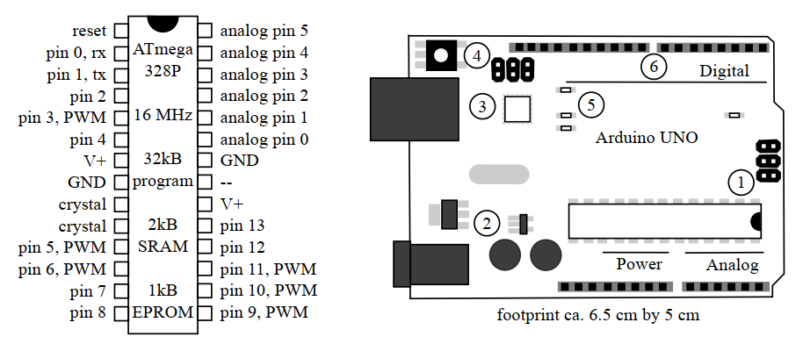
Microcontroller

